Slide 1
Expedia & Airbnb SQL Database Project
By
Juan Moctezuma-Flores

Slide 2



What is the goal of this database?
The purpose of this project is to create a relational database that stores Expedia (flight information only) and Airbnb data on behalf of the fictitious low-cost third party known as “JLMFCompany”. This fictional enterprise allows the user to book flights and/or reserve Airbnb listings throughout the non-existent “Expedia Airbnb App (EApp)” for a fraction of the cost.

Slide 3





Data Tools & Software
A) Microsoft Office:
• Microsoft Excel
• Microsoft PowerPoint
• Microsoft Word
B) SQL Server:
• Azure Data Studio (platform)
• Extra tools:
• Docker Desktop
• Kitematic
C) Python 3:
• PyCharm CE – Platform
• Uncommon libraries/modules:
• xlwt
• Faker
D) Draw.io – Online Diagramming Software

Slide 4




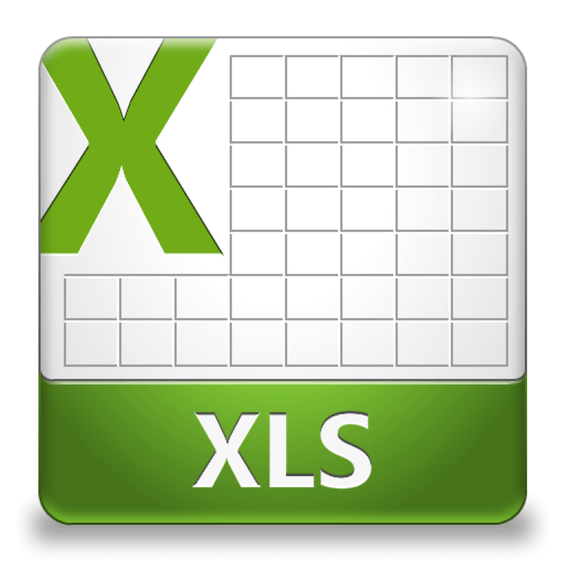
Tables by Category
• JLMFCompany’s database is composed of 11 tables (structures that collect or store data from Microsoft Excel ➟ CSV files). These tables are stored in Azure Data Studio (SQL Server).
• List of tables by category:
A) User and records data:
• BOOKINGS
• USER_ACCOUNT
• USER_RECORDS
• CARD_DETAILS
B) Airbnb data:
• AIRBNB_BOOKING_DATA
• AIRBNB_RESERVATION_DETAILS
• HOST_INFO
• REVIEWS
C) Expedia data:
• EXPEDIA_PASSENGER_DATA
• EXPEDIA_PASSENGER_TICKETS
• EXPEDIA_TRIP_DETAILS

Slide 5
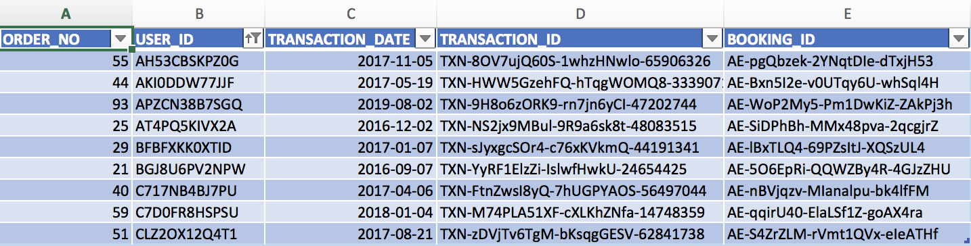
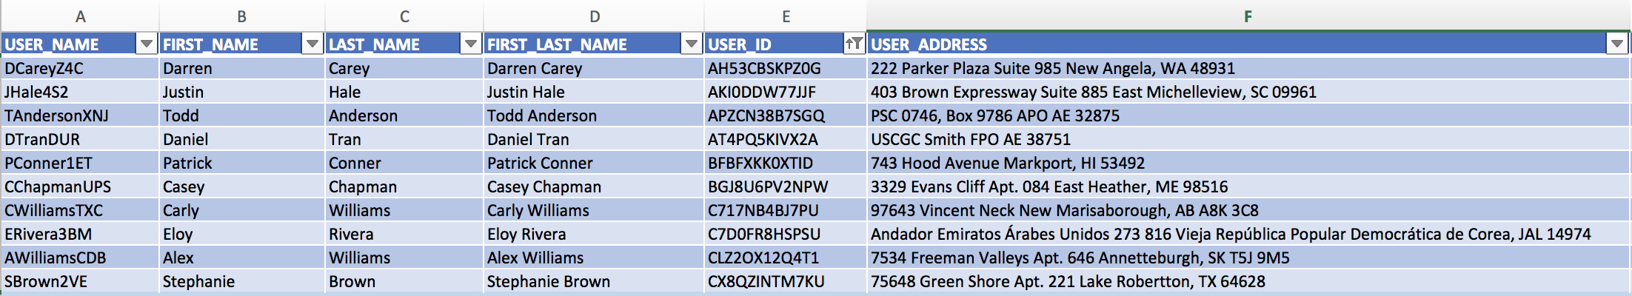
Tables by Category (Part 2)
Each table has columns or fields; these relate with fields of other tables. For example, the user’s id (Excel/CSV column) from USER_ACCOUNT relate with the user’s id field from USER_RECORDS.

Slide 6
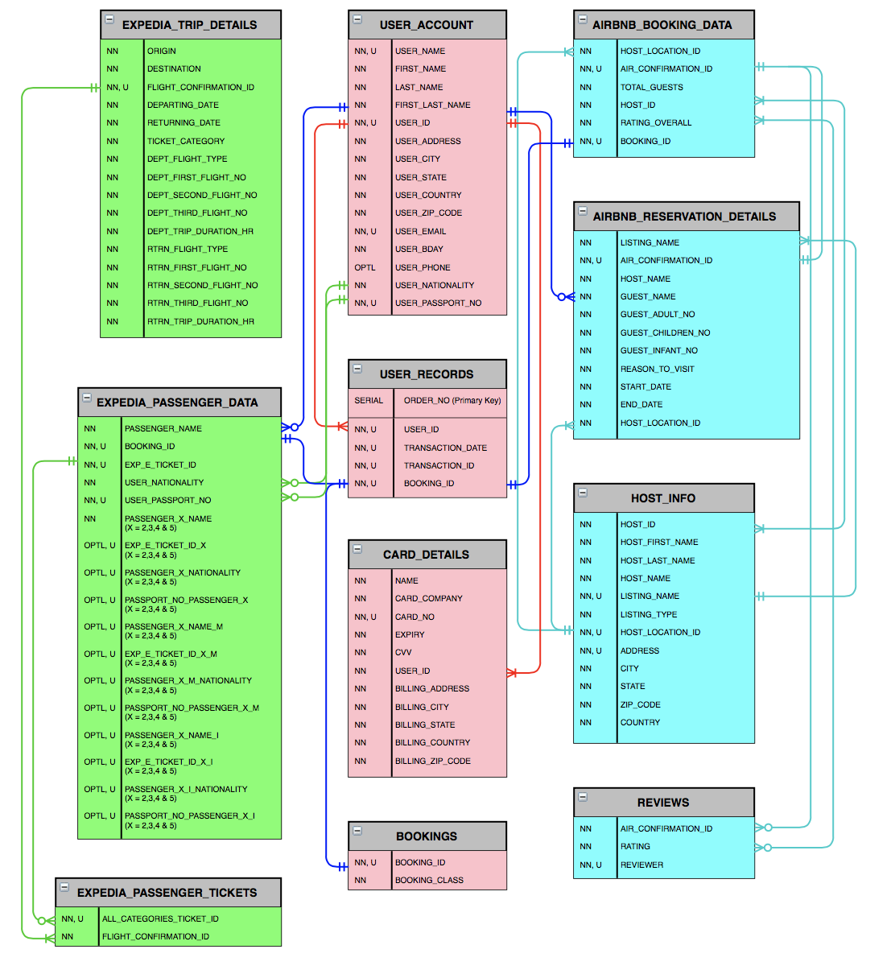
JLMFCompany’s Data Model:
Entity Relationship (ER) Diagram
• The image contained in this slide represents the database’s tables. Next slide (Page 6) displays a bigger image of the same ER Diagram (ERD).
• Tables contain a list of their respective columns. Meaning that every field seen in each Excel file, get reflected appropriately in SQL Server (Azure Data Studio), as long as these were loaded with the correct format.
• Page 7 contains the ERD’s detailed description.

Slide 8
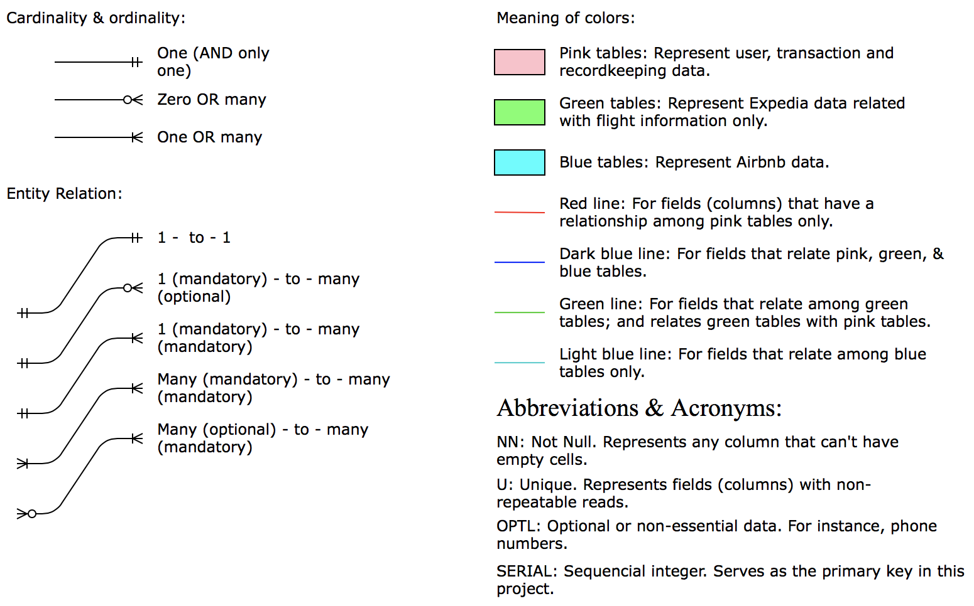
Entity Relationship (ER) Diagram
Symbols & Description

Slide 9
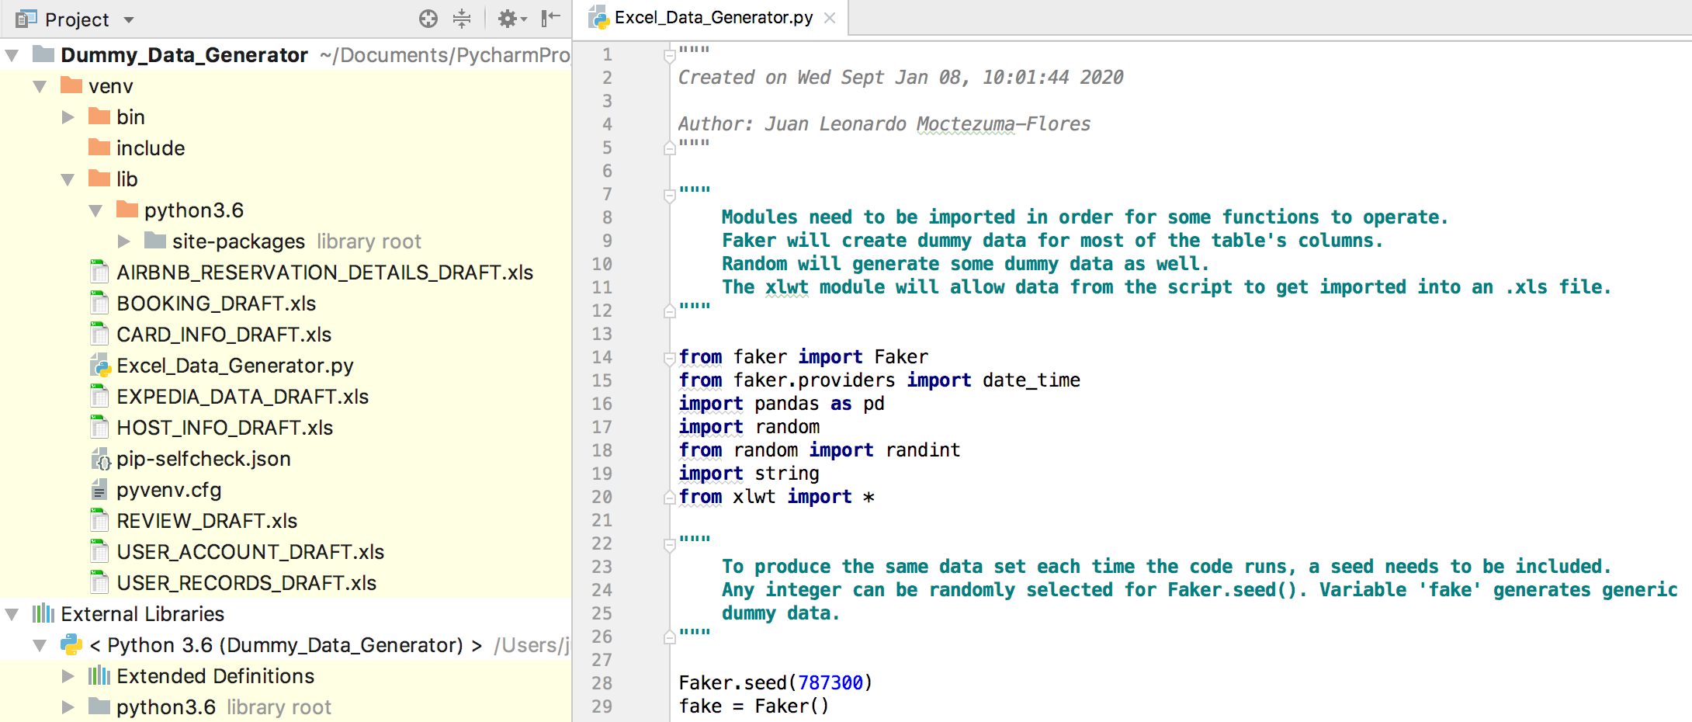
Dummy Data: Python’s role
• Most columns were filled with fake information; in addition, the rest of
the columns required manual cleansing or manipulation for consistency
purposes.
• Unfortunately, the Faker module (package: bogus data generator)
Is not able to generate consistent data for every Microsoft Excel column.

Slide 10
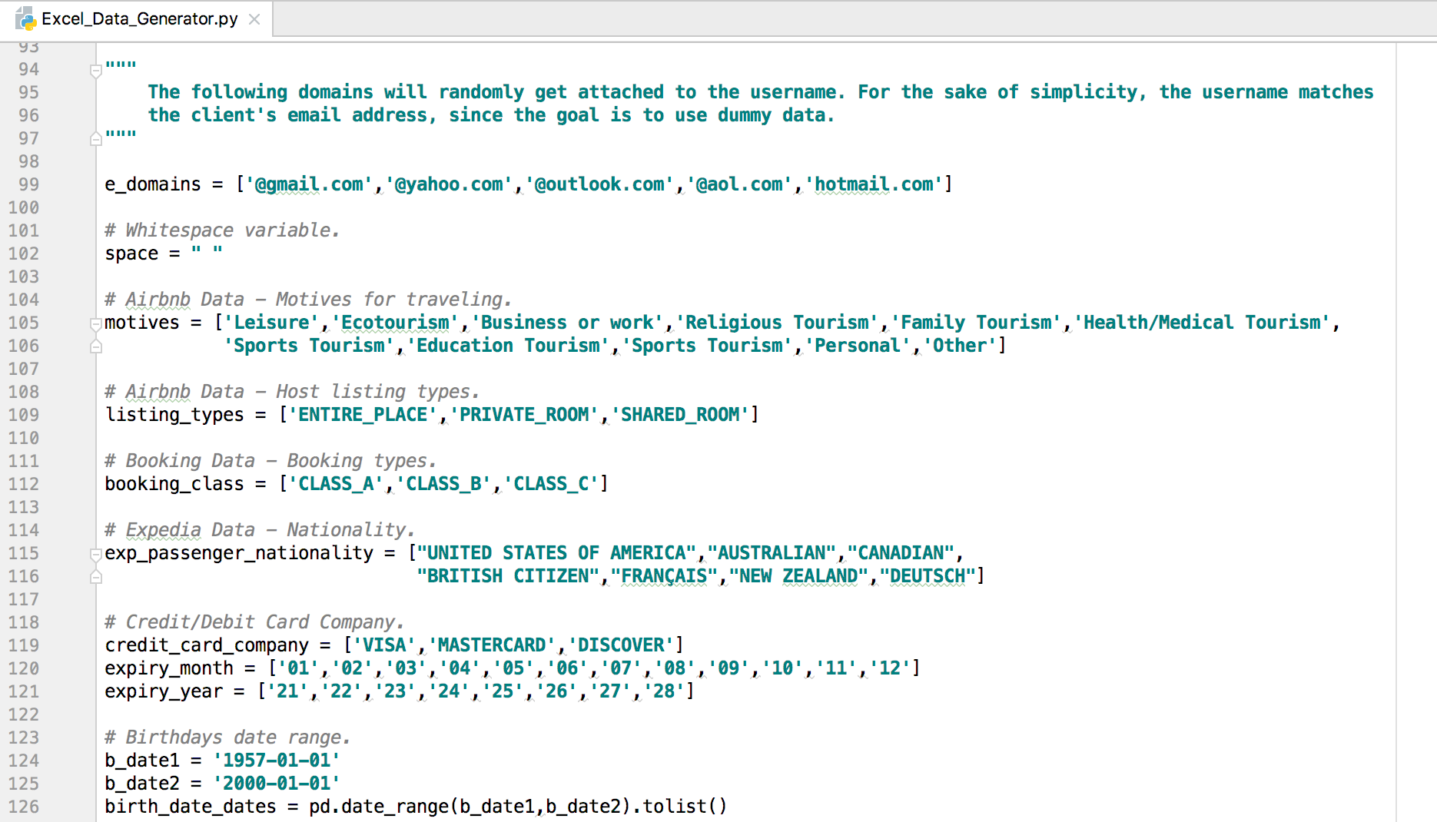
Dummy Data: Python’s role (Part 2)
Most of the data generated by the Python script/code involves information
regarding full names, credit/debit cards, unique identifiers, dates, emails,
users’ phone numbers, citizenships, addresses, etc.

Slide 11
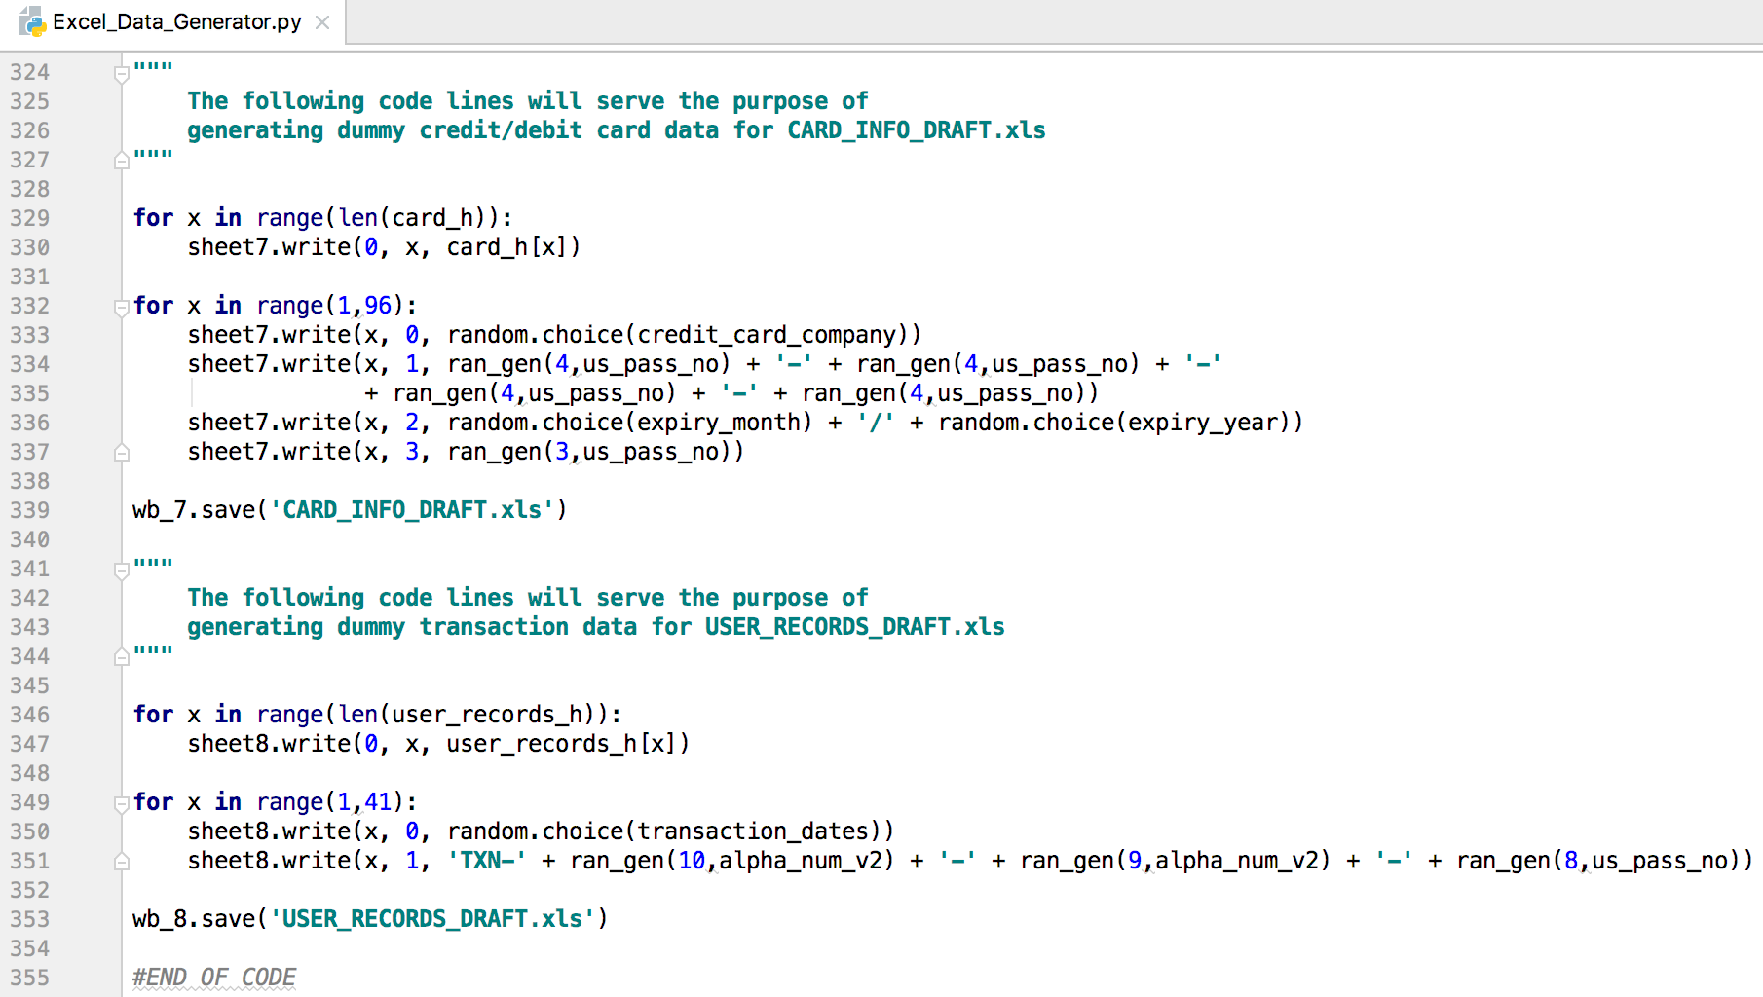
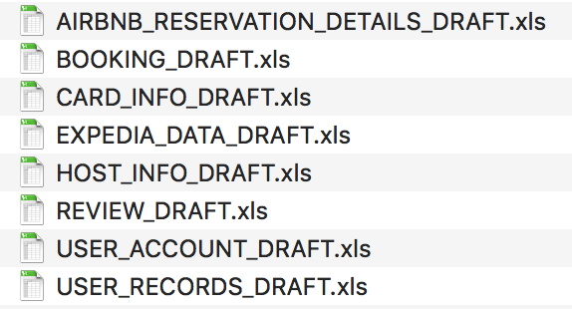
Dummy Data: Python’s role (Part 3)
Different data types or categories (based on their respective tables) were
generated and compiled into distinct XLS files. These were then carefully
reviewed and manually manipulated, before being loaded into the database.
Note: Although there are 11 tables, only 8 files with dummy data were produced.

Slide 12
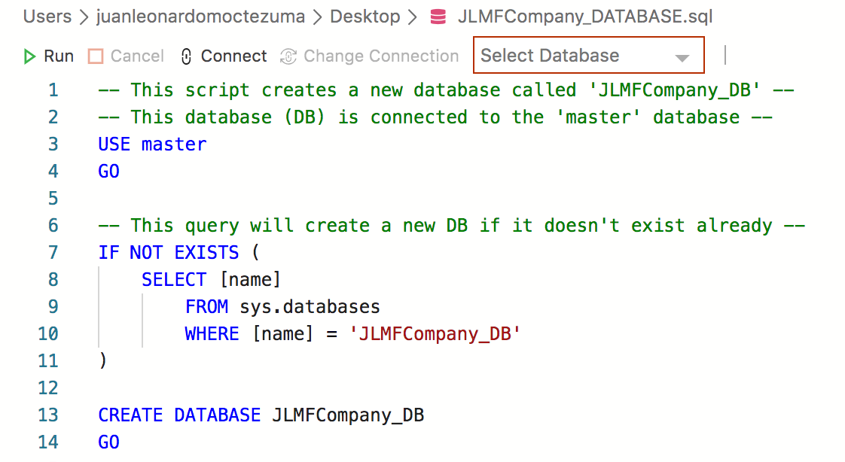
SQL Server: Database Script

Slide 13
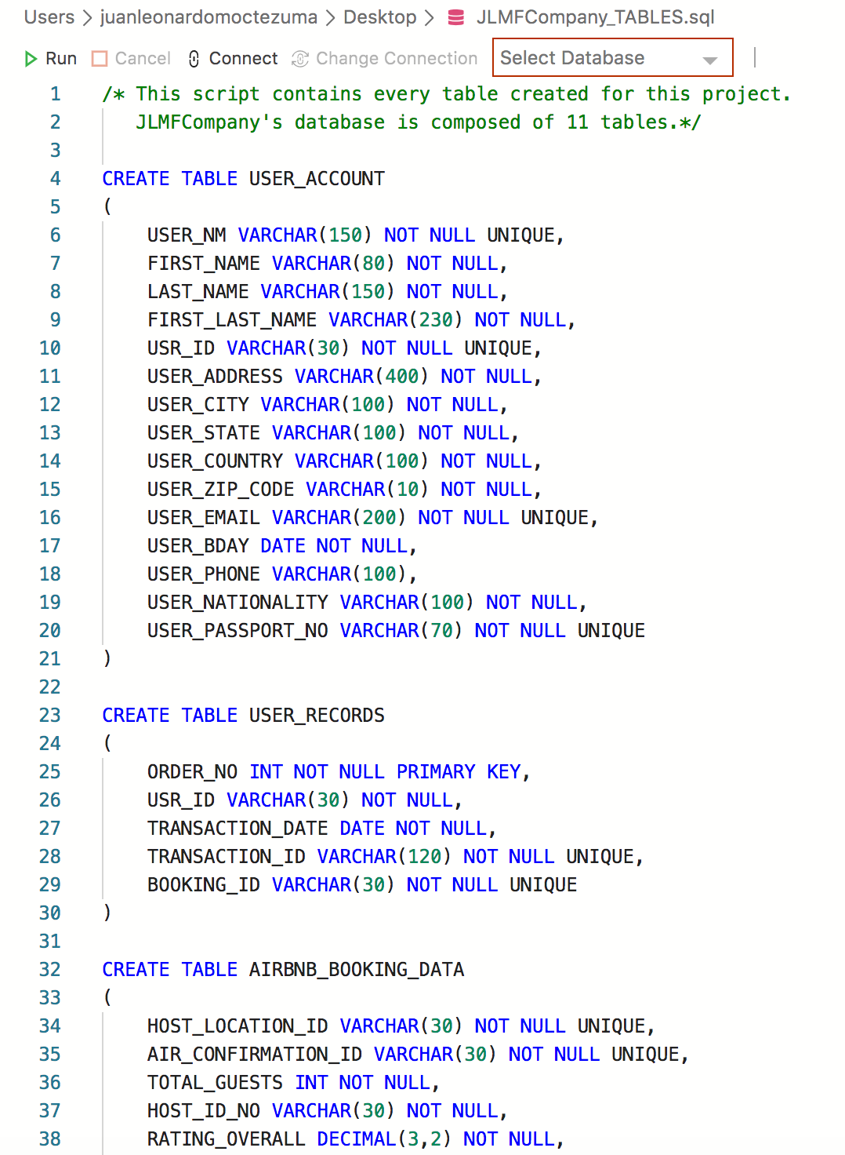
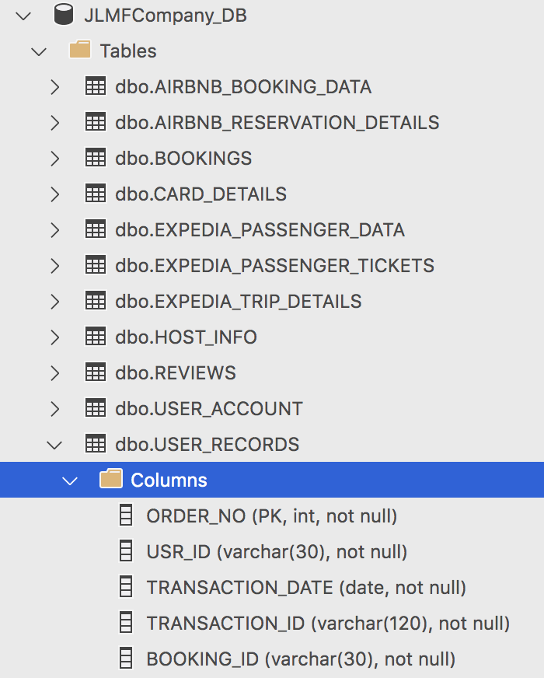
SQL Server: Tables Script

Slide 14
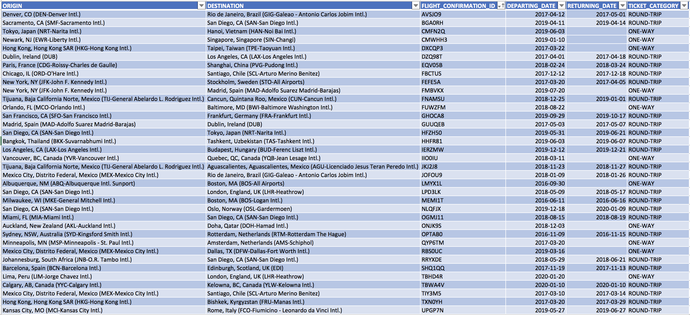
What happens when you load data?
Please observe the EXPEDIA_TRIP_DETAILS table (or file), which was created
in Excel. The picture below represents columns A – F.

Slide 15
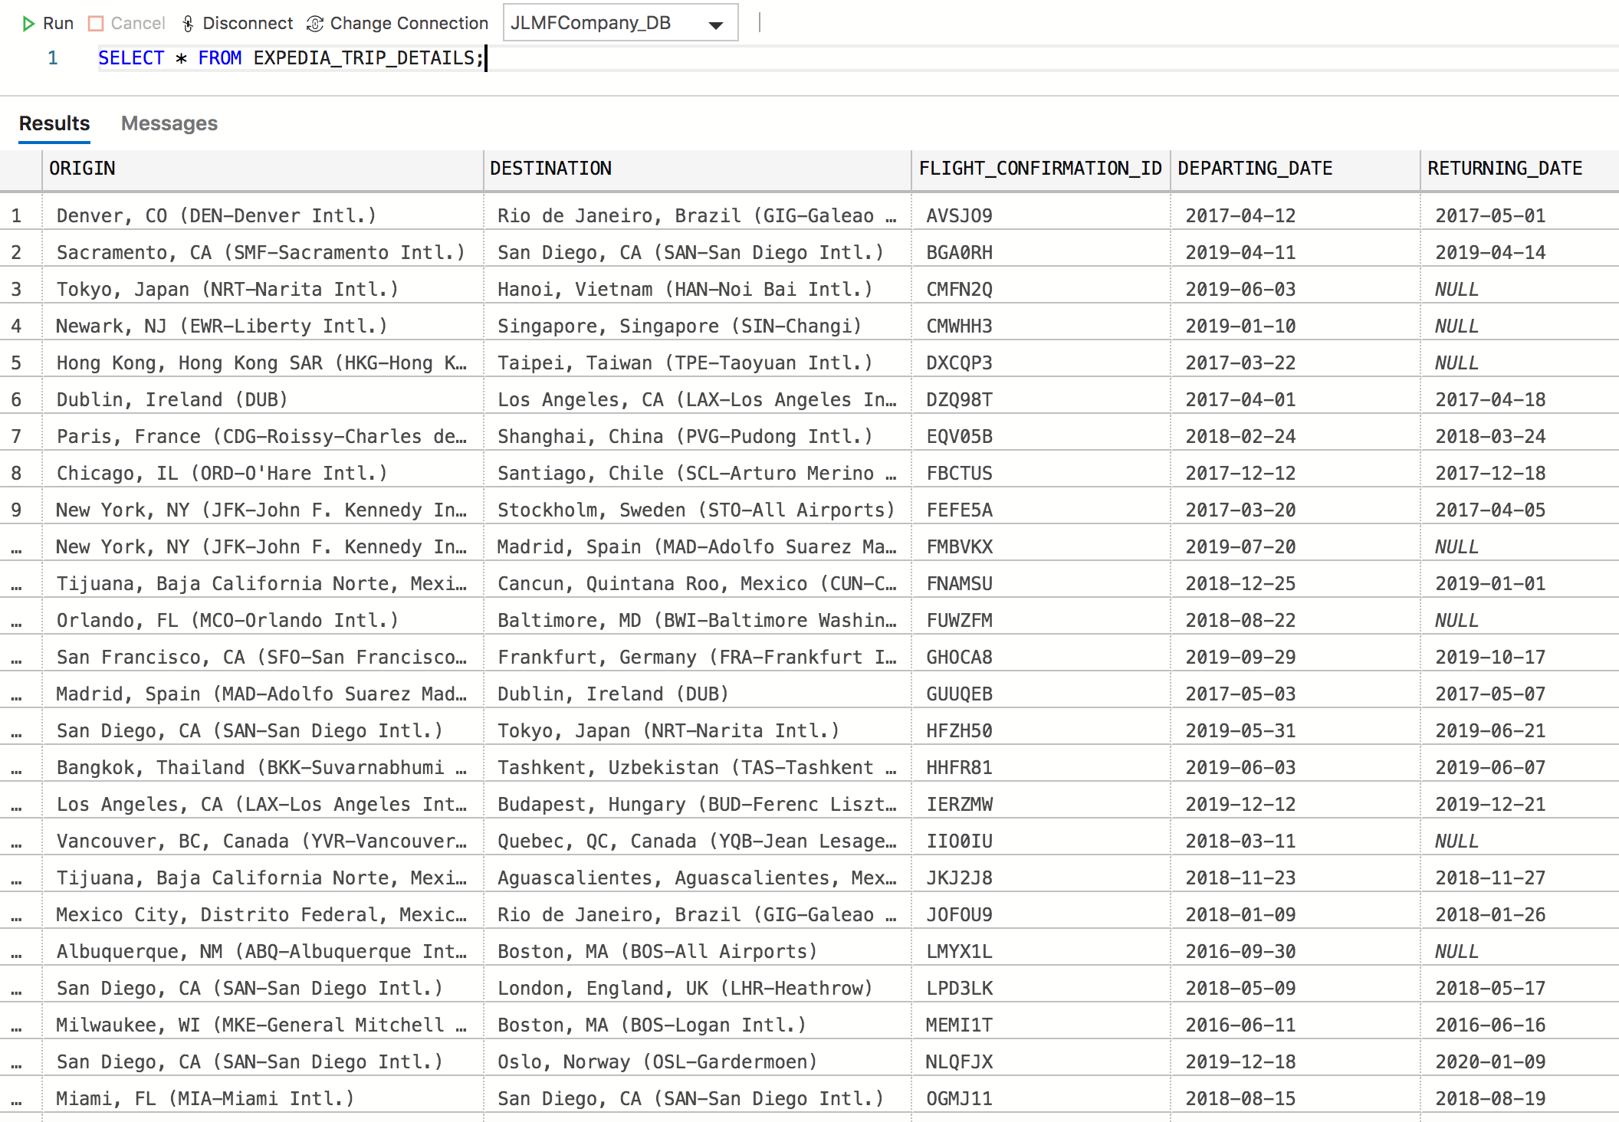
What happens when you load data? (Part 2)
Please observe the EXPEDIA_TRIP_DETAILS table. Data gets loaded (as a CSV file) into Azure Data Studio. The picture below represents columns A – E (Excel file: EXPEDIA_TRIP_DETAILS.xlsx).

Slide 16
What else can be done with the stored data?
• Run SQL queries for verification purposes.
• Observe trends and patterns.
• Calculate numerical data.
• Combine or join data that corresponds to different tables.
• Research.
The following slides (pages 17 – 23) consist of a series of research questions that were written by the author of this presentation. These questions include the queries (and their respective results) that were used to find the answers.

Slide 17
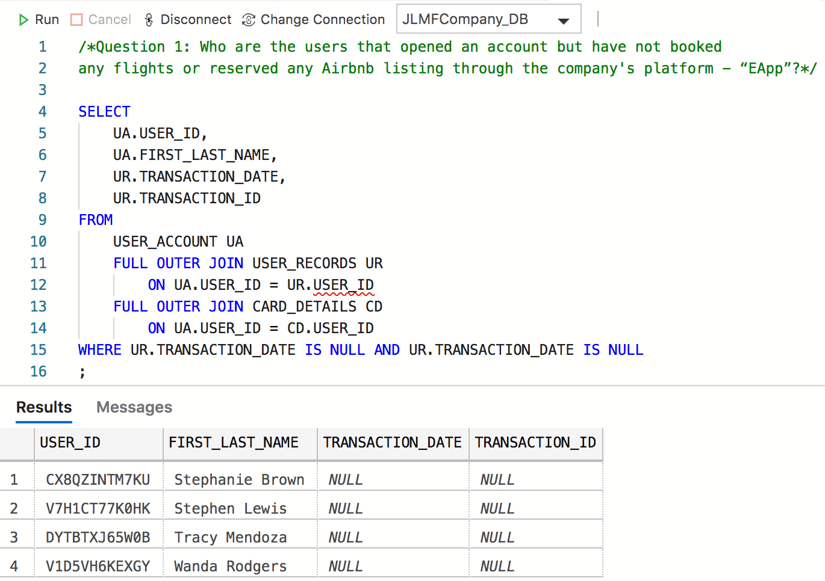
Research: Observation

Slide 18
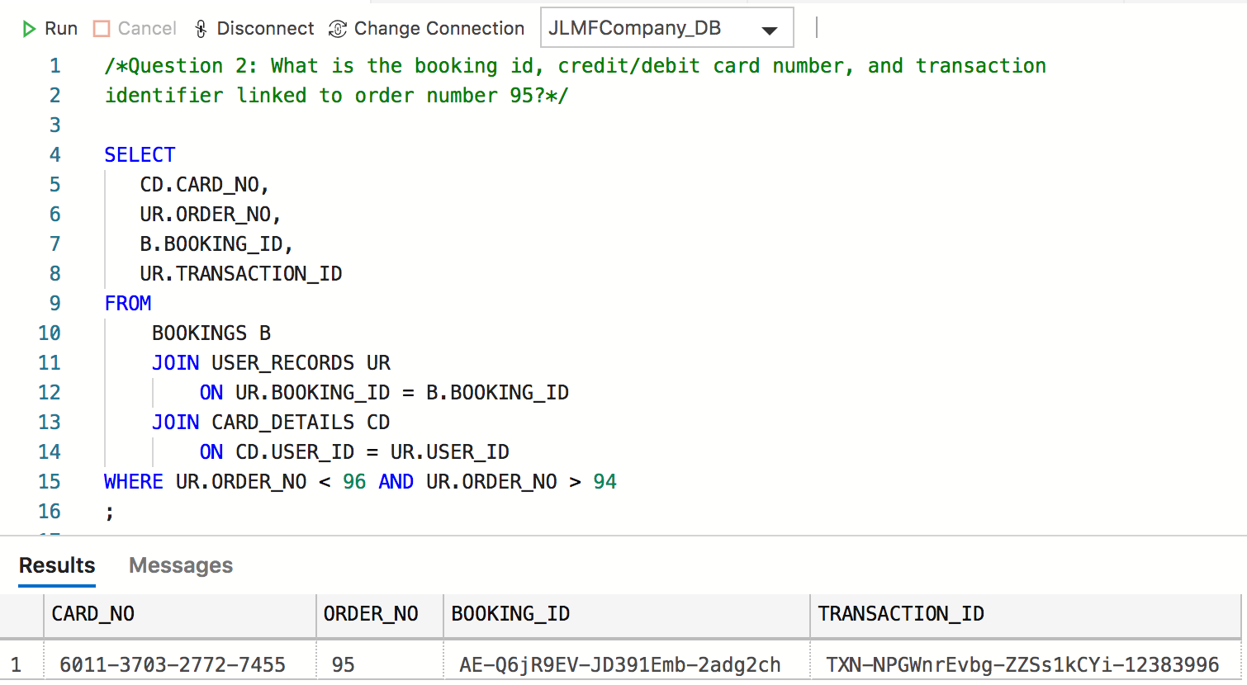
Research: Record lookup

Slide 19
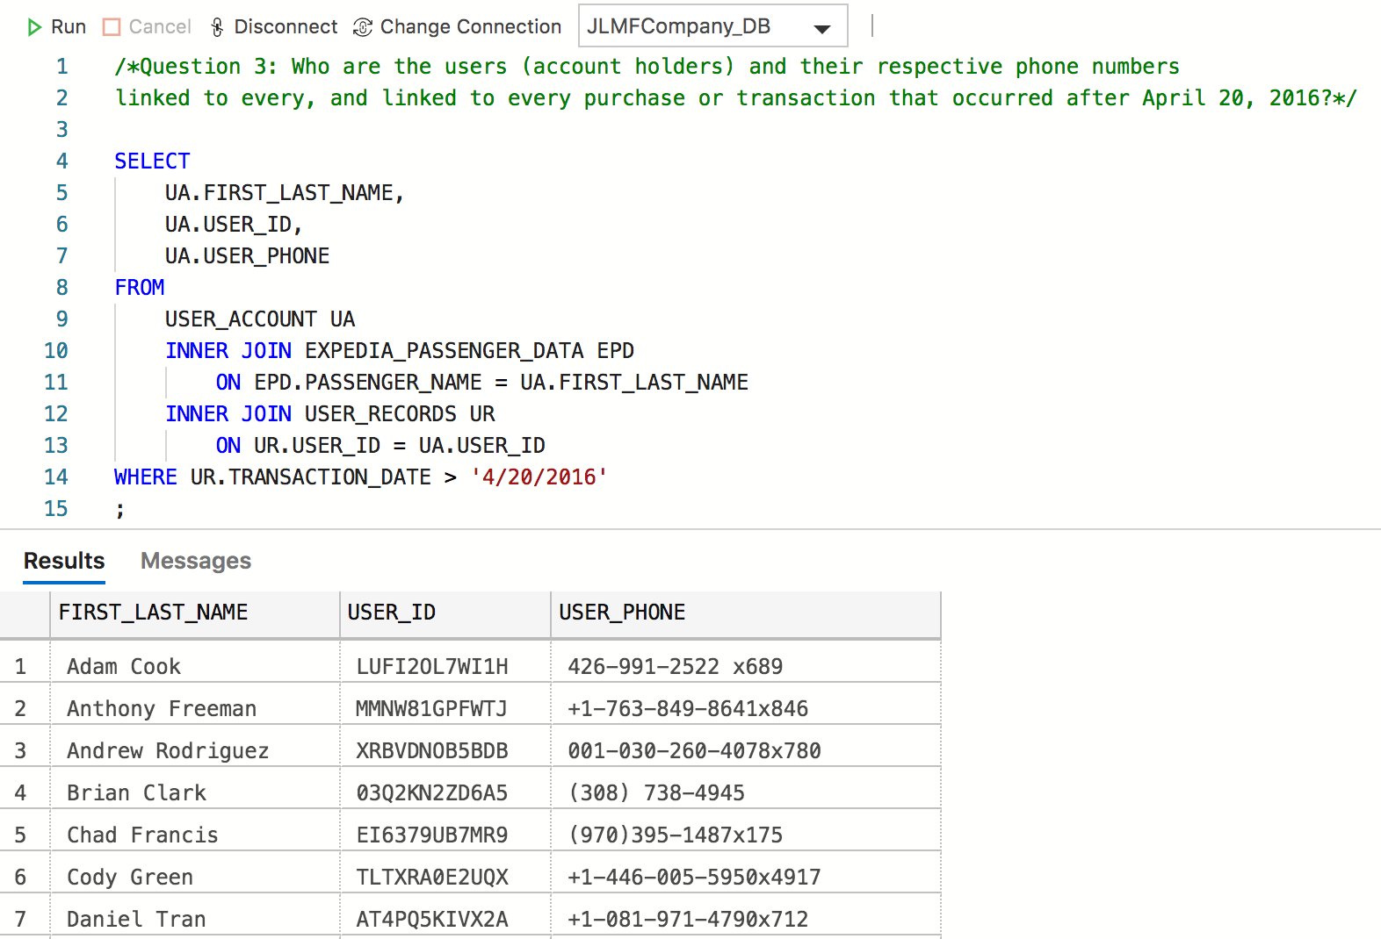
Research: Date Range & Filtering

Slide 20
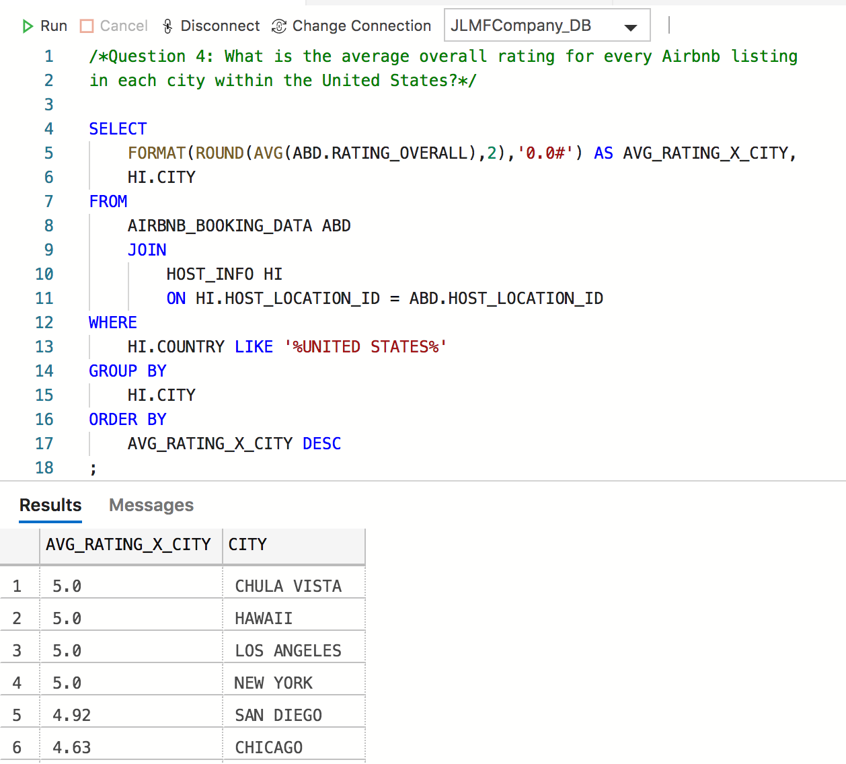
Research: Numerical - Average

Slide 21
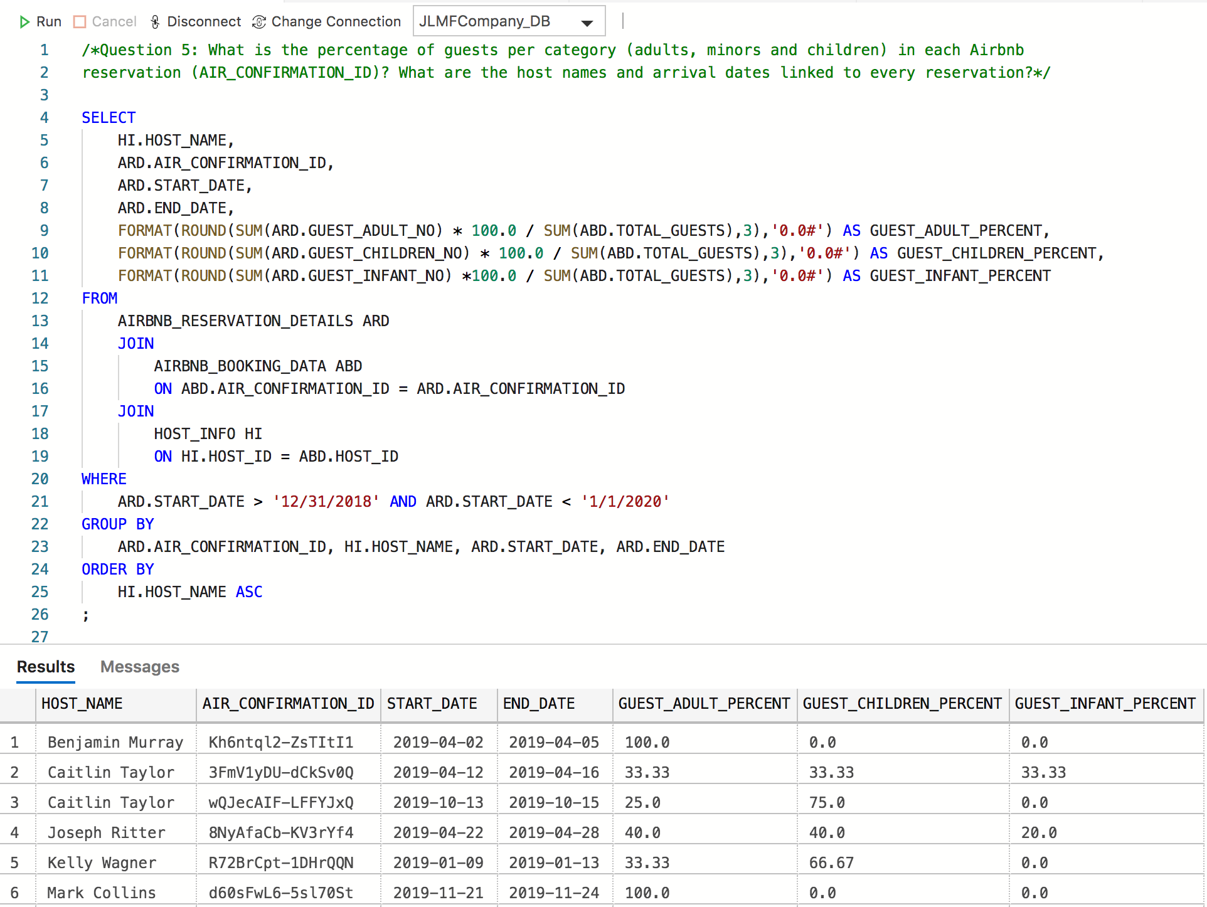
Research: Numerical - Percentage

Slide 22
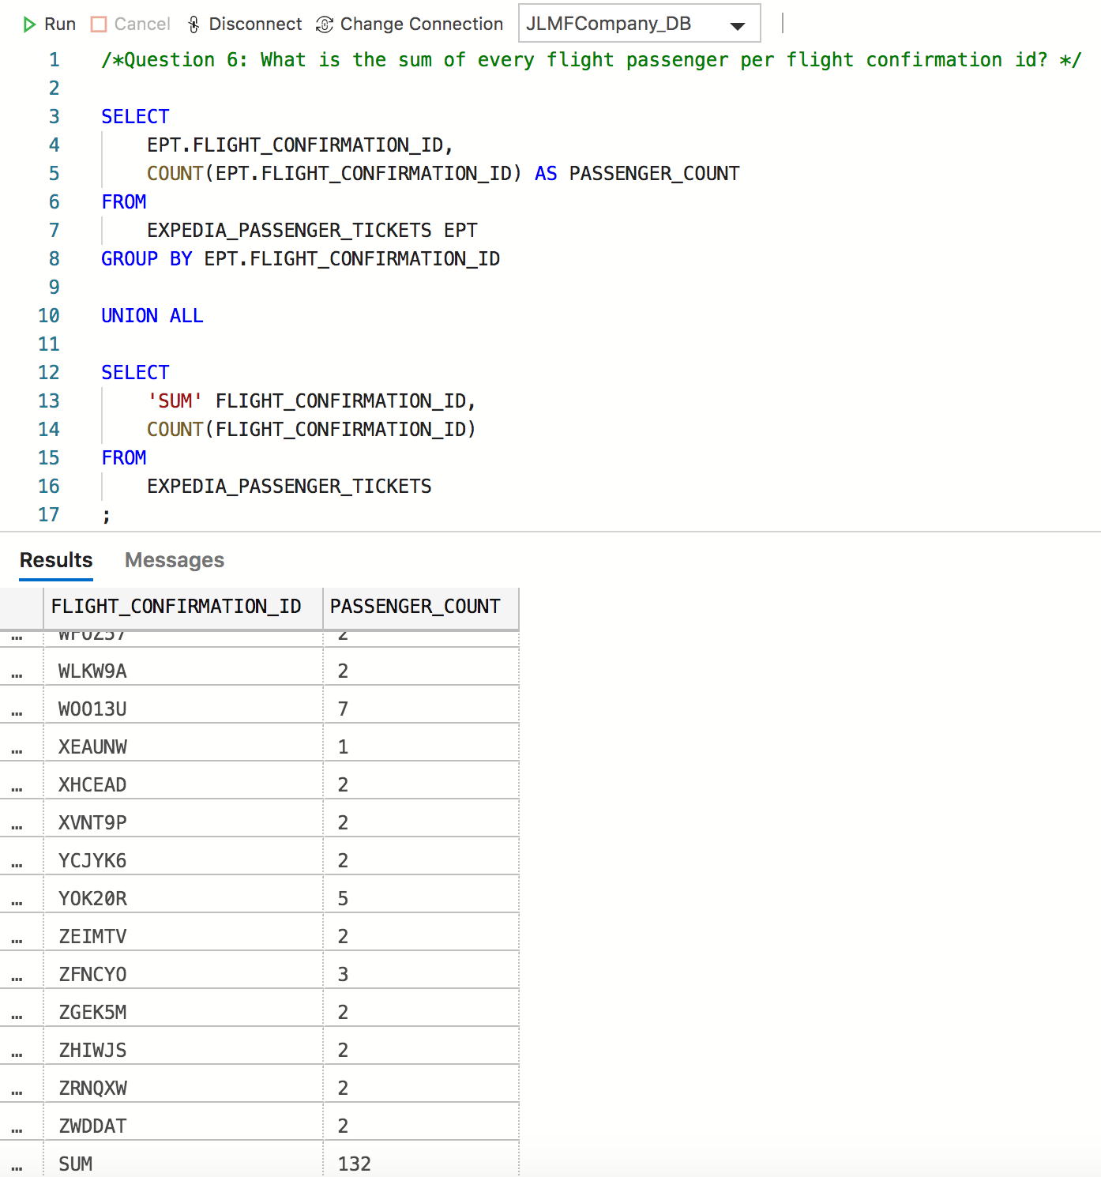
Research: Numerical - Sum

Slide 23
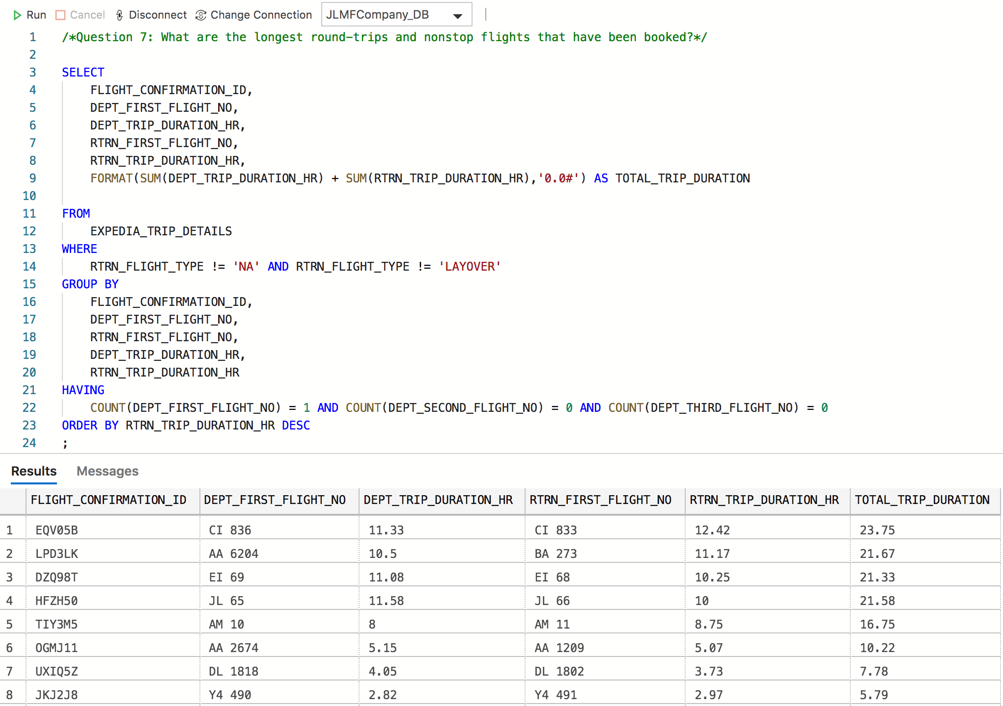
Research: Trends & Patterns

Slide 24
CONCLUSION
• The ERD’s purpose is to demonstrate the relationship among
the user & records, Airbnb and Expedia data tables.
• This data model is designed to maintain every data set organized, and
hence avoid inconsistencies or data duplication.
• Testing the database throughout SQL queries is necessary to confirm
that data was loaded correctly.
• Analyzing some research questions might help enterprises to improve
their overall business based on insights, trends, or patterns.

Slide 25
Reference Sources
Docs.microsoft.com. (2020). [MS-SQLPROTLP]: Technical Documents. [online] Available at:
https://docs.microsoft.com/en-us/openspecs/sql_server_protocols/ms-sqlprotlp/3432cb95-3f91-446d-86d7-b9ea0816464e
[Accessed 19 Feb. 2020].
Docs.microsoft.com. (2020). Microsoft Azure Documentation. [online] Available at: https://docs.microsoft.com/en-us/azure/
[Accessed 19 Feb. 2020].
Docs.microsoft.com. (2020). SQL Server technical documentation - SQL Server. [online] Available at:
https://docs.microsoft.com/en-us/sql/sql-server/?view=sql-server-ver15 [Accessed 19 Feb. 2020].
Docs.python.org. (2020). 3.8.2rc2 Documentation. [online] Available at: https://docs.python.org/3/
[Accessed 19 Feb. 2020].
Inside Airbnb. (2020). Inside Airbnb. Adding data to the debate. [online] Available at:
http://insideairbnb.com/get-the-data.html [Accessed 19 Feb. 2020].
Faker.readthedocs.io. (2020). Welcome to Faker’s documentation! — Faker 4.0.1 documentation. [online] Available at:
https://faker.readthedocs.io/en/master/ [Accessed 19 Feb. 2020].
Lucidchart.com. (2020). [online] Available at:
https://www.lucidchart.com/pages/ER-diagram-symbols-and-meaning [Accessed 19 Feb. 2020].
Openflights.org. (2020). OpenFlights: Airport and airline data. [online] Available at:
https://openflights.org/data.html [Accessed 19 Feb. 2020].
Oracle Help Center. (2020). Database Documentation - Database Documentation. [online] Available at:
https://docs.oracle.com/en/database/ [Accessed 19 Feb. 2020].
W3schools.com. (2020). SQL Tutorial. [online] Available at: https://www.w3schools.com/sql/ [Accessed 19 Feb. 2020].
Worldpostalcode.com. (2020). World Postal Code - free zip/postal code lookup. [online] Available at:
https://worldpostalcode.com [Accessed 19 Feb. 2020].

